Slide 1
OFDM in WiFi Channels
Tyler McKean & Zachary Garnes

Slide 2
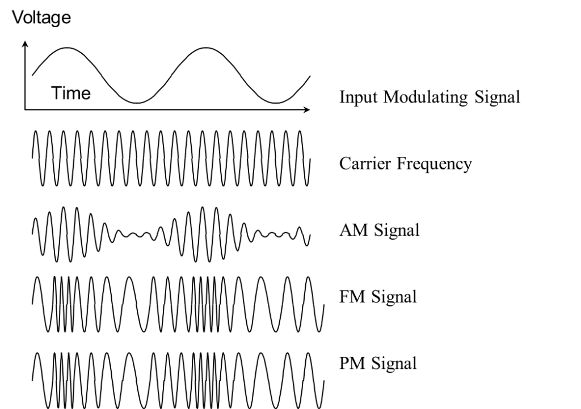
Introduction - Modulation
Modulation refers to a carrier signal that may be varied so that some information can be embedded into carrier and transmitted over air or cable
Amplitude Modulation - AM Radio
Frequency Modulation - FM Radio/Audio
Phase Modulation - Data/WiFi
The receiving end then demodulates the signal to recover the original message
All telecommunication systems use some variation of these types of modulation/demodulation
“Modem” - modulates and demodulates

Slide 3

WiFi Background
Wireless Fidelity
Transmits and Receives data on two operating frequencies
2.4GHz - covers further distance, slow speeds
5GHz - less coverage, faster speeds
Acts as mmWave radio communicator with devices
Non-iodized/low power radiation
safer than the sun’s uv rays
IEEE defined 802 networking specifications
802.3 - ethernet
802.15 - bluetooth
802.11 - WiFi
a,b,g,n,ac,ax - different data rates of transmission

Slide 4
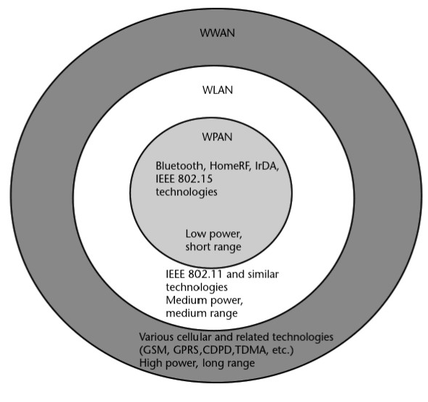
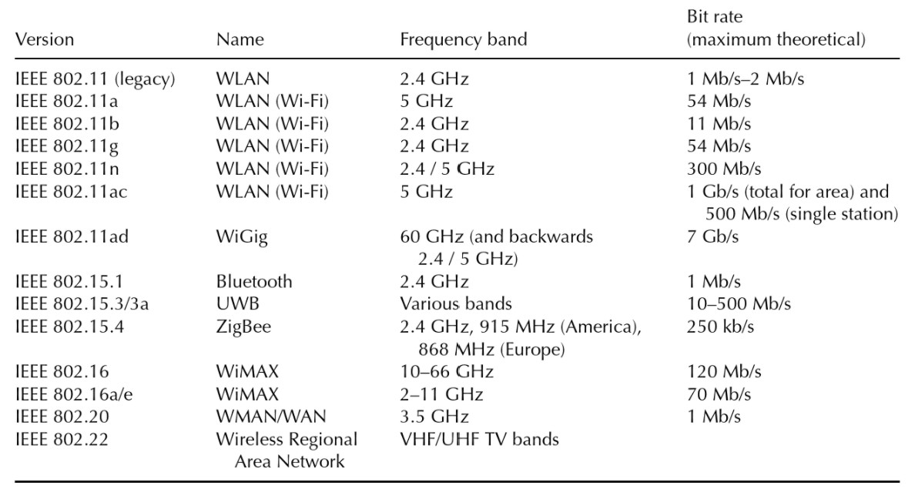
IEEE 802.11 Standards
IEEE has a wide range of standards for Wireless devices
802.11a (1999)
5GHz, 54Mbps, 52 OFDM subcarriers
802.11b (1999)
2.4GHz, 11Mbps, redundant today
802.11g (2003)
2.4GHz, 54Mbps, OFDM
802.11n (2009)
5GHz, 140-300Mbps, MIMO, WiFi-4
802.11ac (2013)
5GHz, 500M-1Gbps, MIMO, WiFi-5
[5]
[5]

Slide 5
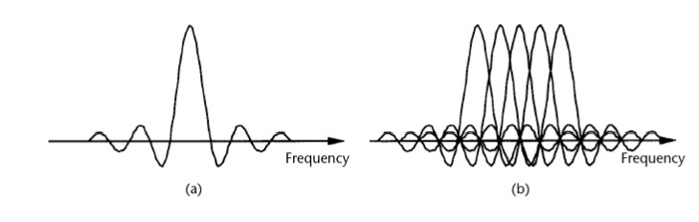
Orthogonal Frequency Division Multiplexing
OFDM is a special case of multicarrier transmission, where a single data stream is transmitted over a number of lower-rate subcarriers (SCs) [2]
Can be seen as a modulation technique or a multiplexing technique. [2]
Traditional format of sending data over a radio channel is sent serially
Relies on single channel and any interference on that single frequency can disrupt whole transmission [3]
OFDM transmits data in parallel across various carriers - “substreams”
Reduces interference among symbols which increases symbol reception accuracy while maintaining the same throughput
Spectra of OFDM subchannel (a) and OFDM signal (b). [2]

Slide 6
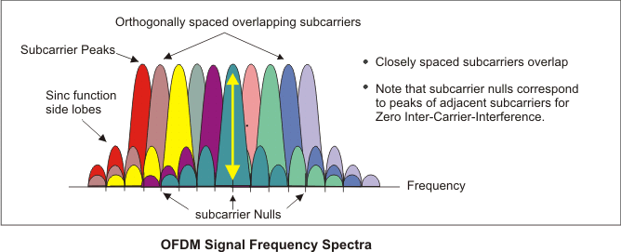
Importance of Orthogonality
Data bits (pulses) in the T.D. look like sinc function in F.D. from Fourier Transform
Carriers are linearly independent (orthogonal) if the carrier spacing is a multiple of 1/T or sampling frequency
Where T is the period of the baseband sampling frequency
Peaks of subcarriers line up with nulls of adjacent subcarriers - orthogonality
Receivers acts as a bank of demodulators, calculates correlation values with center frequency of each SC and can recover the transmitted data with no cross talk.
[7]

Slide 7
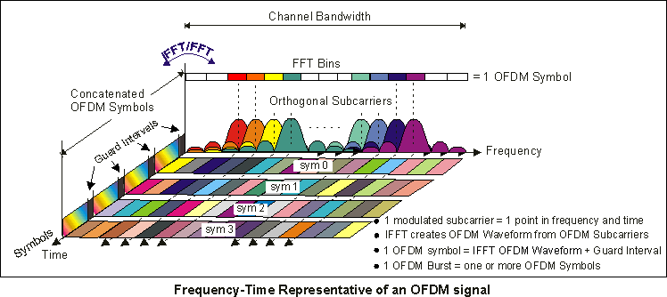
Symbols and Cyclic Prefix (Guard Intervals)
Symbol - the time period in which a group of data bits are mapped to an analog pulse shape and modulated onto the carrier
Symbol rate - frequency at which groups of data bits are modulated onto the carrier
Number of subcarriers divided by Sampling frequency = Period of One OFDM symbol
Cyclic Prefix - the space between symbols, added to the front of each symbol during transmission
Consecutive OFDM symbols spaced sufficiently to avoid multipath
Convolution of transmitted symbols with channel is circularly symmetric, ensures orthogonality
[7]

Slide 8
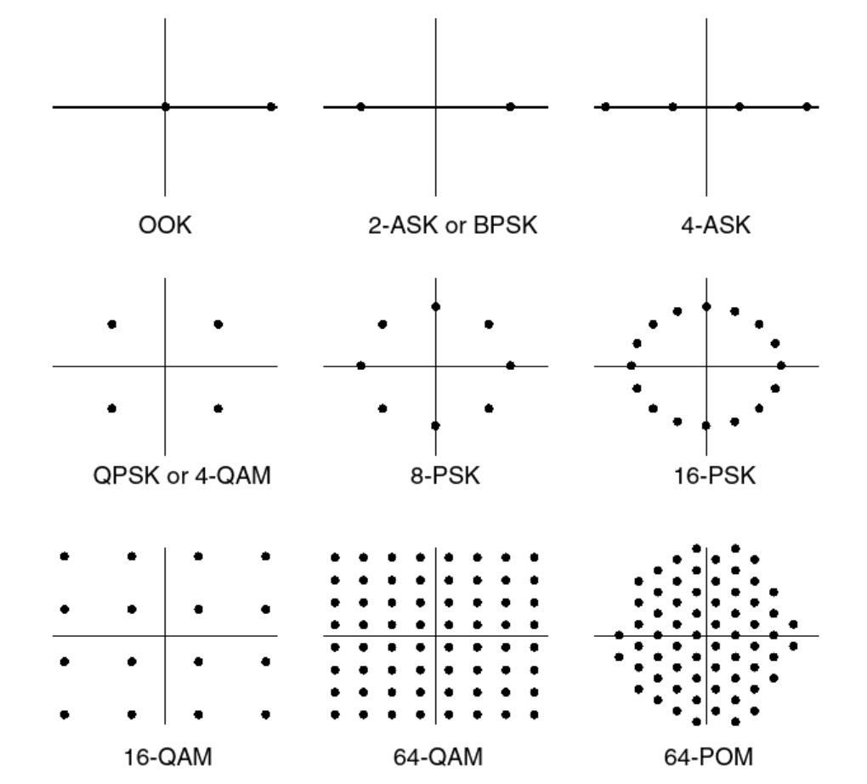
ASK & PSK
Amplitude Shift Keying (ASK) - map digit bits to an analog carrier signal
1 being a positive amplitude
0 being a negative amplitude
Phase Shift Keying (PSK) - modulate digital data to a carrier signal by applying data-dependent phase shifts
Equivalent to 2-ASK by using 180° phase shifts
Binary Phase Shift Keying
Quaternary Phase Shift Keying (QPSK) - four different possible phase shifts applied to carrier signal
2 bits per symbol
Quadrature Amplitude Modulation (QAM) - combo of ASK/PSK
Possible constellation points arranged in polar coordinates
4-QAM - 2 bits form 4 possible constellation points
16-QAM - 4 bits form 16 possible constellation points
Polar diagrams for different amplitude and phase modulation schemes. [5]

Slide 9
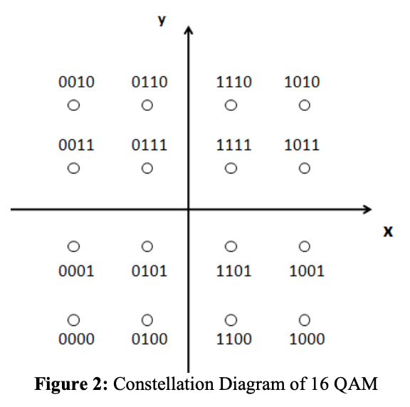
OFDM Modulation
OFDM transmitter maps the message bits into a sequence of PSK or QAM symbols
16-QAM, 64-QAM, 256-QAM
QAM modulation scheme acquires higher data rate, that is, higher bandwidth efficiency, by sacrificing power utilization.
Higher SNR to maintain low bit error rate
[6]

Slide 10
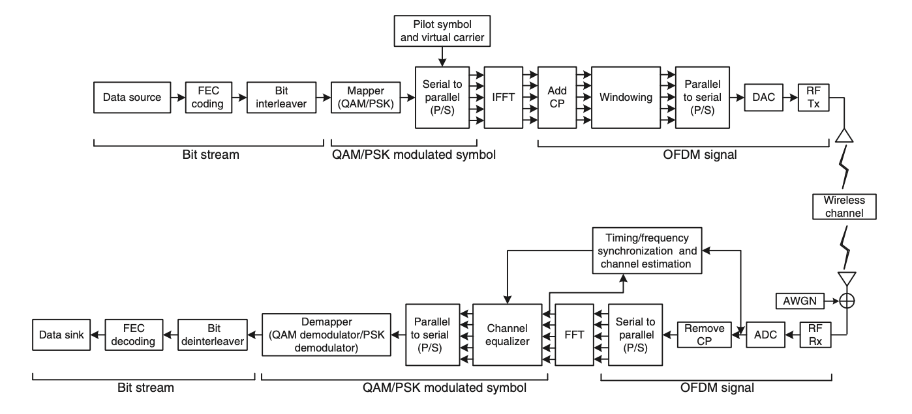
OFDM Architecture
[8]

Slide 11
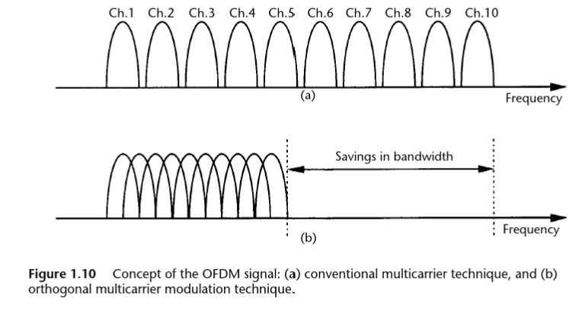
Advantages of OFDM
Immunity to Selective Fading
Resistant to frequency selective fading than SC systems
Divides the overall channel into multiple narrowband signals affected individually
Resilience to Interference
Bandwidth limited interference won’t affect all the sub-channels
Not all data will be lost like SC would
Spectrum Efficiency
Orthogonal subchannels allow them to be overlapping without sidelobe interference
Saves room within bandwidth and receiver can equalize individual subchannels easily
[3]

Slide 12
Disadvantages of OFDM
High Peak-to-Average-Power ratio (PAPR)
Noisy amplitude variation and relatively large dynamic range
Impacts the RF amplifier efficiency
Amplifiers need to be linear and accommodate for large amplitude variations
Sensitive to Doppler Shift
Transmitter is moving in relation to the receiver
Movement shifts frequency of the signal, thus frequency perceived by receiver differs than original
Loss in efficiency due to addition of cyclic prefix (guard interval)

Slide 13
Summary
OFDM is the fundamental building block for many modulation schemes that are widely used in wireless communications today.
WiFi, Mobile communications (LTE), PWAN
Provides a reliable signal and higher resilience against interference, fading and other complexities that happen with wireless channels.
Allows for the reliable high speed data that has become normal for the wireless devices that are used today.

Slide 14
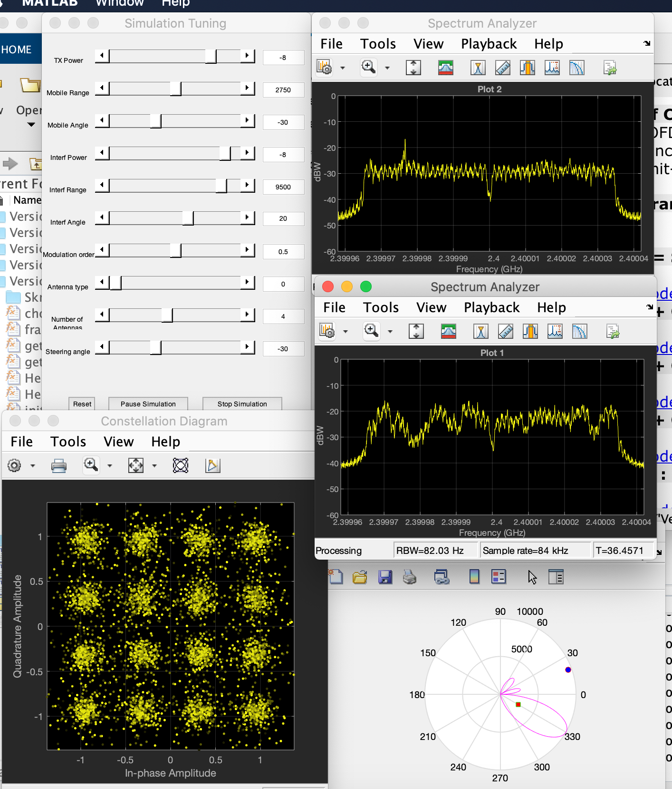
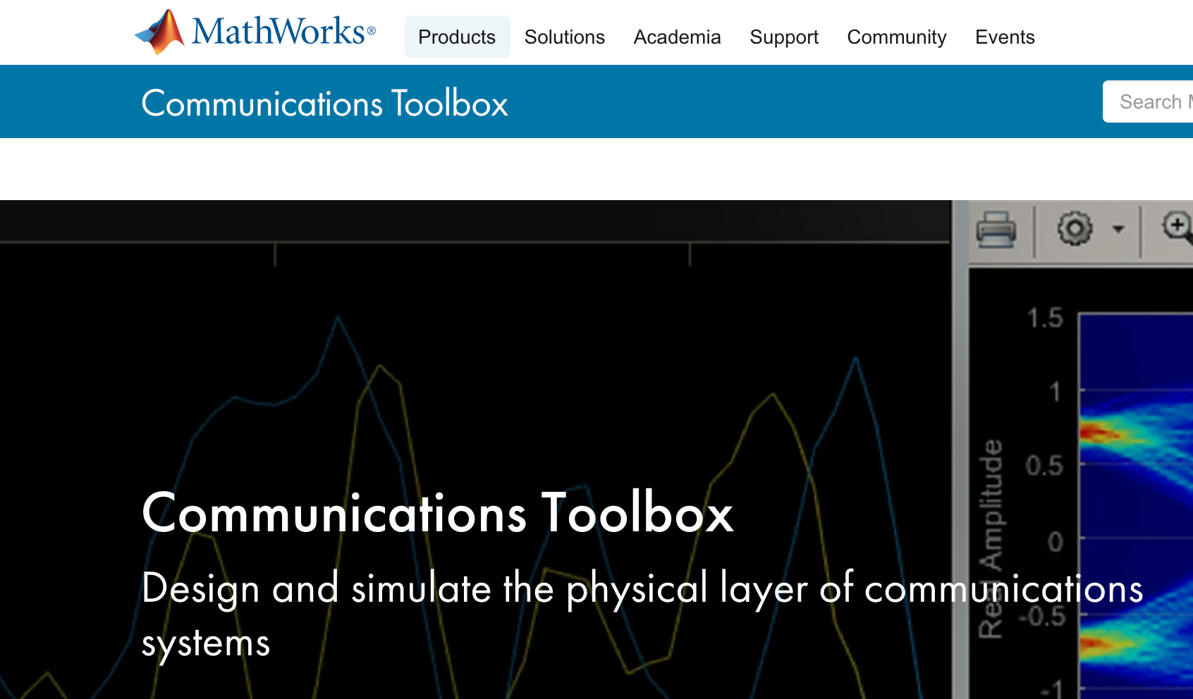

Simulated Channels using MATLAB

Slide 15
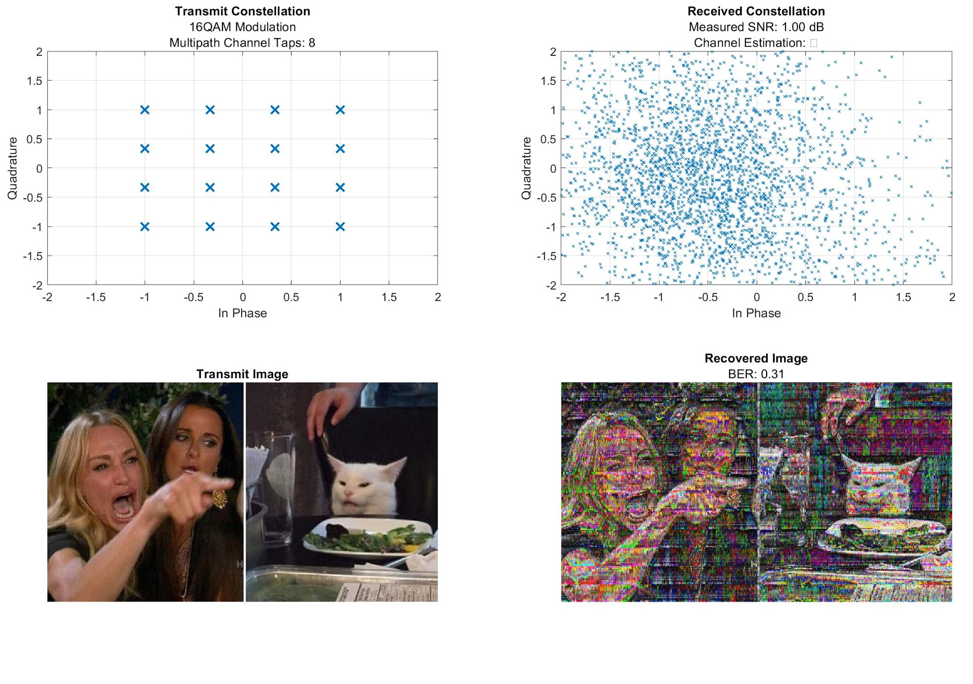
Matlab Example - 16QAM
Want to send a meme to your friend who’s on same WiFi
Transmission of image vs the received image for a 16QAM modulation with desired SNR of 20dB
BER is 31%
Code generated from [9]

Slide 16
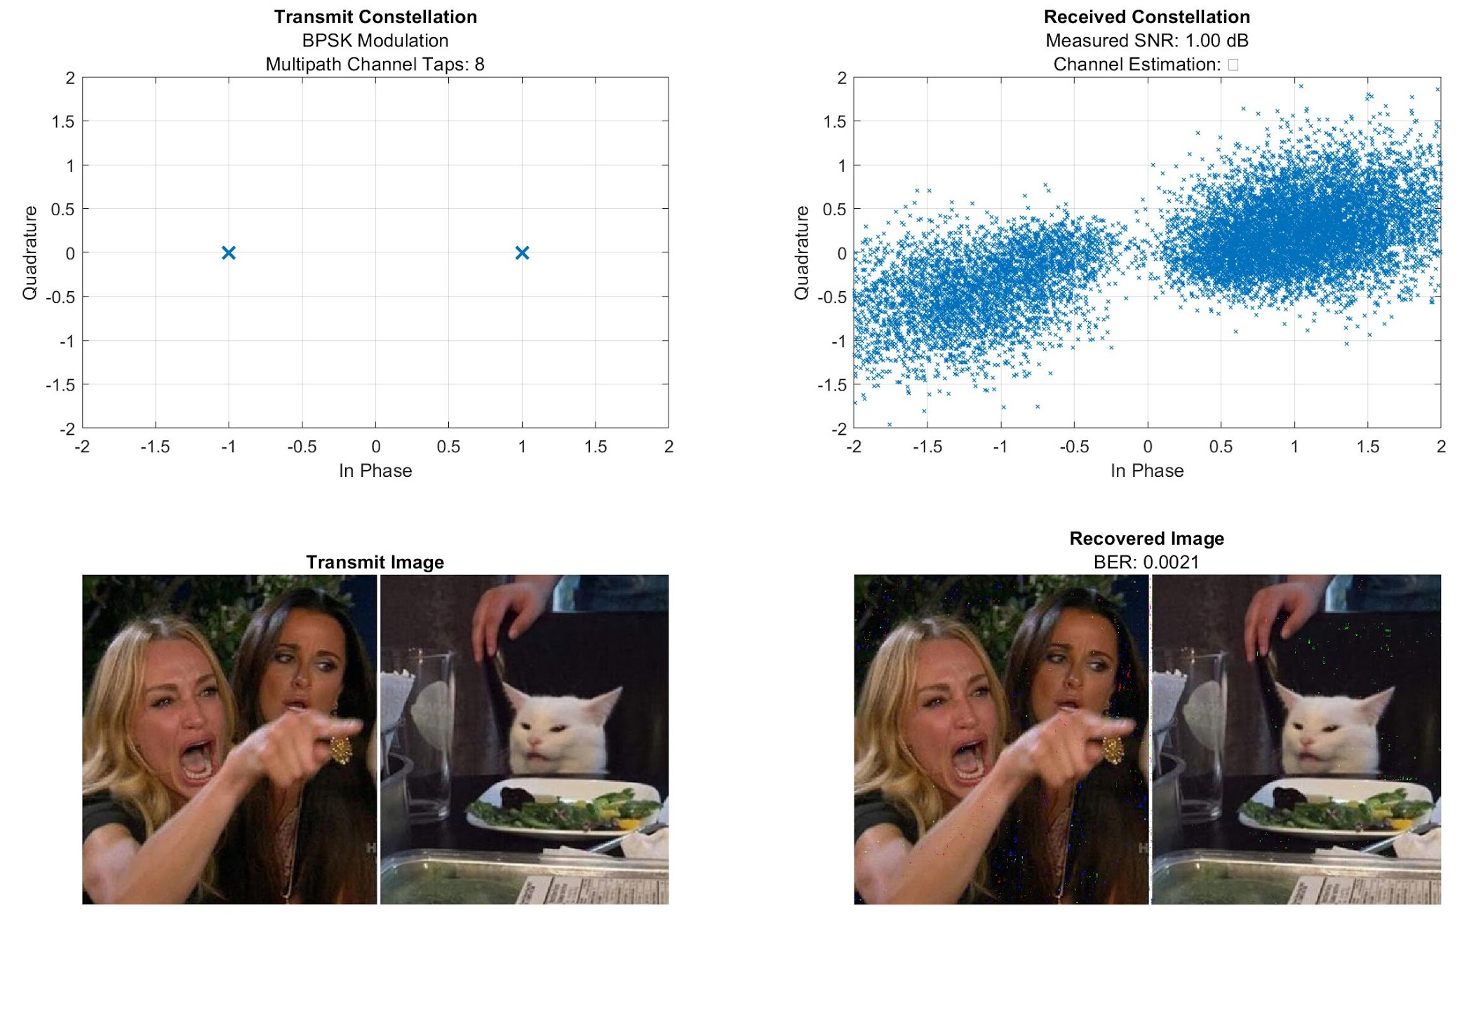
Matlab Example - BPSK
Due to wide variability in noise tolerance from 16QAM, if instead used BPSK modulation with same SNR of 20 dB
BER is about .0021%
Code generated from [9]

Slide 17
References
[1] I. B. Djordjevic and B. Vasic, "100-gb/s transmission using orthogonal frequency-division multiplexing," in IEEE Photonics Technology Letters, vol. 18, no. 15, pp. 1576-1578, Aug. 2006, doi: 10.1109/LPT.2006.879590.
[2] Prasad, Ramjee., and Ebrary, Inc. OFDM for Wireless Communications Systems Ramjee Prasad. Boston: Artech House, 2004. Artech House Universal Personal Communications Ser. Web.
[3] E. Notes, “What is OFDM: Orthogonal Frequency Division Multiplexing,” Electronics Notes. [Online]. Available: https://www.electronics-notes.com/articles/radio/multicarrier-modulation/ofdm-orthogonal-frequency-division-multiplexing-what-is-tutorial-basics.php. [Accessed: 12-Dec-2020].
[4] Bharadia, Dinesh, Joshi, Kiran, Kotaru, Manikanta, and Katti, Sachin. "BackFi." Proceedings of the 2015 ACM Conference on Special Interest Group on Data Communication (2015): 283-96. Web.
[5] Penttinen, Jyrki T. J.. The Telecommunications Handbook : Engineering Guidelines for Fixed, Mobile and Satellite Systems, John Wiley & Sons, Incorporated, 2015. ProQuest Ebook Central, https://ebookcentral.proquest.com/lib/umboston/detail.action?docID=1921186.
[6] Pavan Kumar, and Amita Kumari. IOSR Journal of Electronics and Communication Engineering (IOSR-JECE) e-ISSN: 2278-2834,p- ISSN: 2278-8735.Volume 11, Issue 4, Ver. III (Jul.-Aug .2016), PP 66-74 www.iosrjournals.org
[7]Concepts of Orthogonal Frequency Division Multiplexing (OFDM) and 802.11 WLAN. [Online]. Available: http://rfmw.em.keysight.com/wireless/helpfiles/89600B/WebHelp/Subsystems/wlan-ofdm/content/ofdm_basicprinciplesoverview.htm. [Accessed: 14-Dec-2020].
[8]Y. S. Cho, J. Kim, W. Y. Yang, and C. G. Kang, MIMO-OFDM wireless communications with MATLAB. Singapore: Wiley, 2011.
[9] Shujaat Khan (2020). OFDM Channel Estimation in MATLAB (https://www.mathworks.com/matlabcentral/fileexchange/67156-ofdm-channel-estimation-in-matlab), MATLAB Central File Exchange. Retrieved December 14, 2020.

Slide 18
Thank You!

